Slide 1
Registered Company in 2021
CREATED
BY
RAHUL PRADHAN

Slide 2
PROBLEM STATEMENTS:-
1. Number of registered companies state wise.
2. State wise sum of authorized capital and sum of paid up capital.
3. Number of registered companies according to different category.
4. Category wise sum of authorized capital and sum of paid up capital.
5. Number of registered companies according to class.
6. Class wise sum of authorized capital and sum of paid up capital.
7. Type wise number of registered companies.
8. Type wise sum of authorized capital and sum of paid up capital.
9. Number of registered companies according to activity description.
10. Percentage of registrations each month.
11. Number of companies registered under different type and class.
12. Number of different class of companies registered in various months.
13. Sum of authorized capital under different class and type of company.
14. Sum of paid up capital under different class and type of company.
SOURCE OF DATA:-
https://www.kaggle.com/datasets

Slide 3
EXECUTION SUMMARY
The data consists of company uid, date of registration, month name, state, ROC(Registrars of Company), category, class, company type, authorized capital, paid up capital, activity code, activity description.
Dataset is having 54894 rows and 12 columns.
The project is made using pivot table, pivot chart, conditional formatting and slicer.
By using above raw data, and applying formulas we get a clear view of finalized data.
VIDEO LINK:-
https://drive.google.com/file/d/1PtZoKbjyTEGMA-8fJqQIOYYqIdIAmvXl/view?usp=sharing

Slide 4
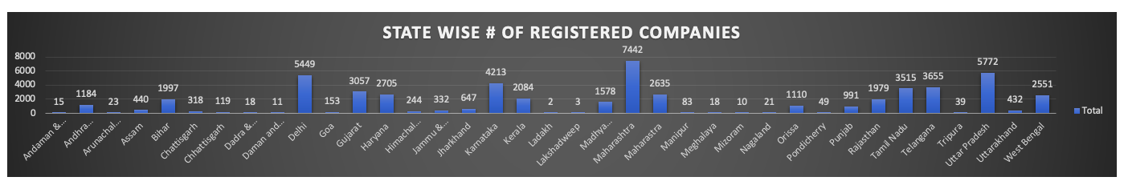
Number of registered companies state wise
This chart consists of the report of number of companies registered in various states of India.
It is observed that the number of companies registered in Maharashtra is far above than its
Respective states where as Ladakh and Lakshadweep are quite low in number in registrations
of company in 2021.

Slide 5
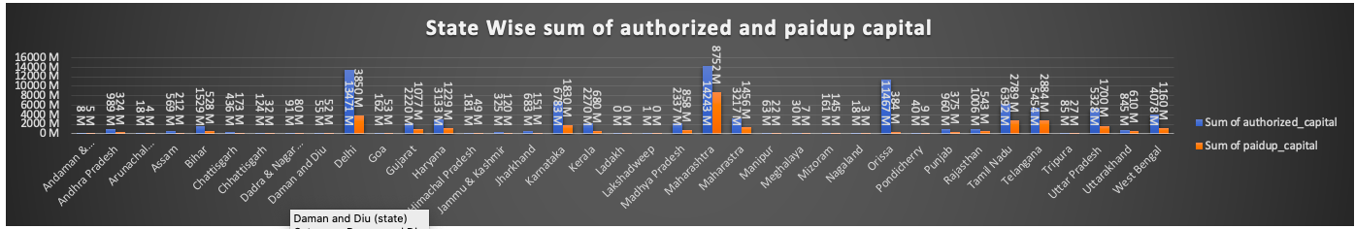
State wise sum of authorized capital and sum of paid up capital
This chart shows the report of sum of authorized capital and sum of paid up capital in different
States. Here again Maharashtra is leading the chart in terms of the sum of authorized capital
Having a value of 14243M where as Ladakh scores the lowest having zero. Then Maharashtra
also having the highest sum of authorized capital that is 8752M and Ladakh securing the
Lowest rank having zero.

Slide 6
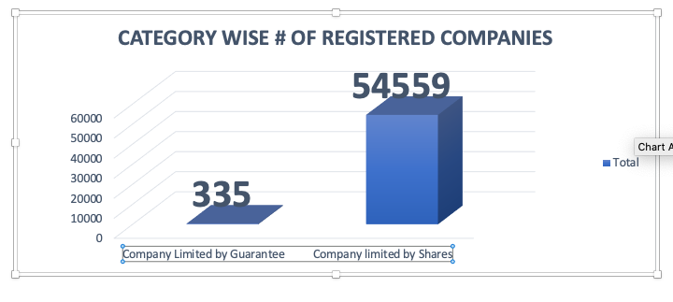
Number of registered companies according to different category
The chart gives an idea about the grouping
Of companies in accordance to their categories.
It can be observed that the category of company
Limited by shares have a higher number of
Registered companies that is 54559 than the
Category of company limited by Guarantee.

Slide 7
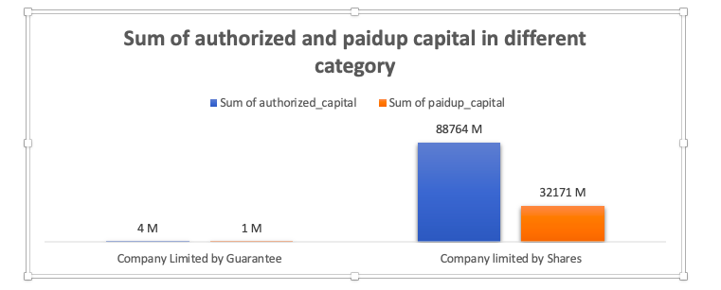
Category wise sum of authorized capital and sum of paid up capital
This chart consist of two categories and it is shown the authorized capital of company limited shares is greater than company limited shares and same goes for the sum of the paid up capital.

Slide 8
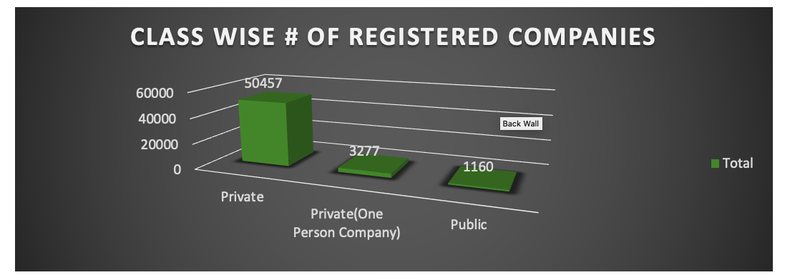
Number of registered companies according to class
This indicates the total number of registered companies in different class where private class has the highest number of registered companies.

Slide 9
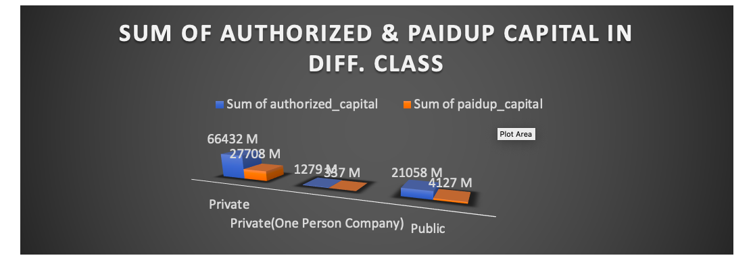
Class wise sum of authorized capital and sum of paid up capital
This shows the sum of authorized capital and the sum of the paid up capital where in private both the sum of capitals are higher than their respective classes. And One person company stays at the bottom

Slide 10
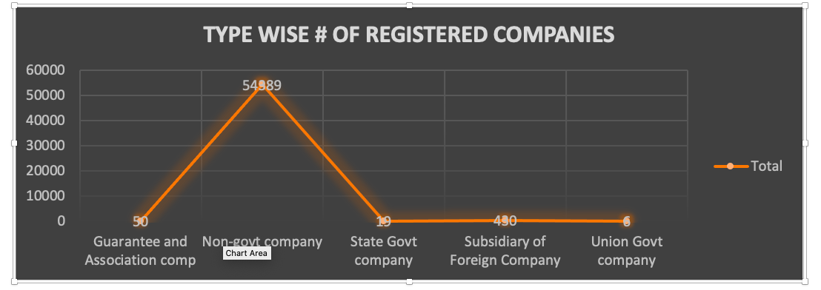
Type wise number of registered companies
This chart indicates different company types and how many companies registered in it in 2021. The Non-govt scores higher with a large margin where union Govt company scores lowest.

Slide 11
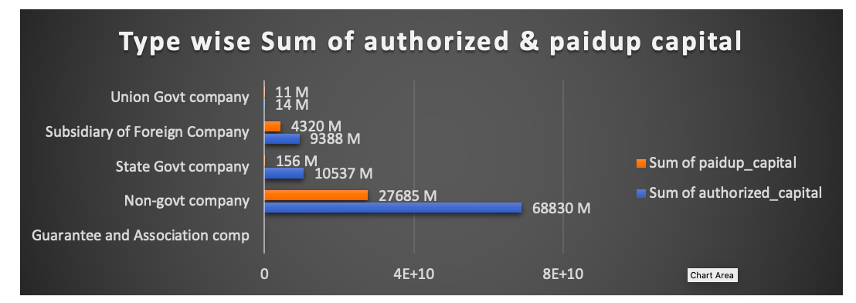
Type wise sum of authorized capital and sum of paid up capital
Here it is clearly shown the sum of paid up capital and the sum of authorized capital stands at the top of the table where as the Guarantee and Association comp having zero.

Slide 12
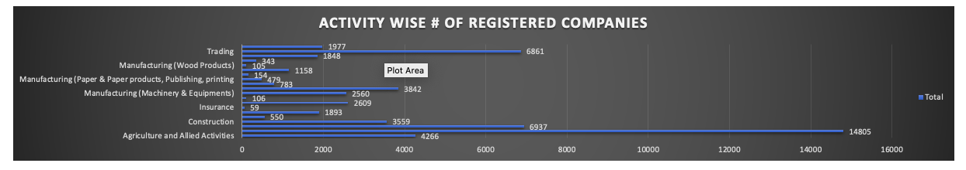
Number of registered companies according to activity description
It indicates the number of registered companies in accordance to their activities. It shows the agricultural activities has the highest number of companies registered.
Here it is also shown that activities in accordance to insurance scores the lowest.

Slide 13
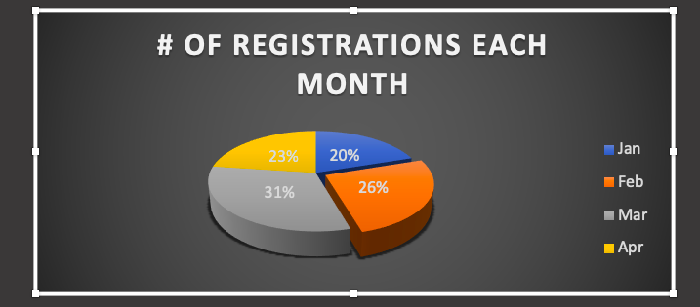
Percentage of registrations each month
This chart represents the percentage of companies registrations month wise in 2021. It can be observed that March has the highest percent and January has the lowest.
It can also be seen that the month February is the smallest yet shown the highest percentage of companies registered

Slide 14
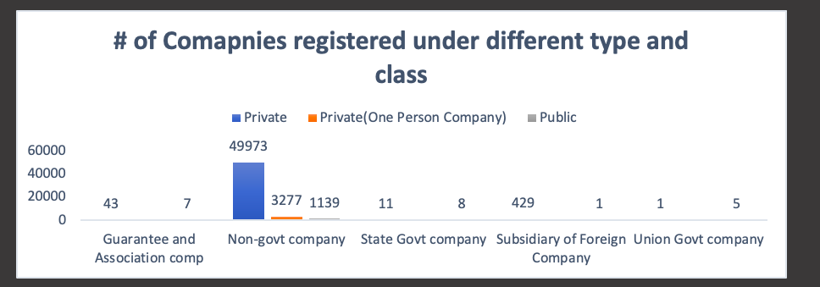
Number of companies registered under different type and class
This graph shows the highest companies that registered are private non-govt companies and the lowest is union govt companies.

Slide 15
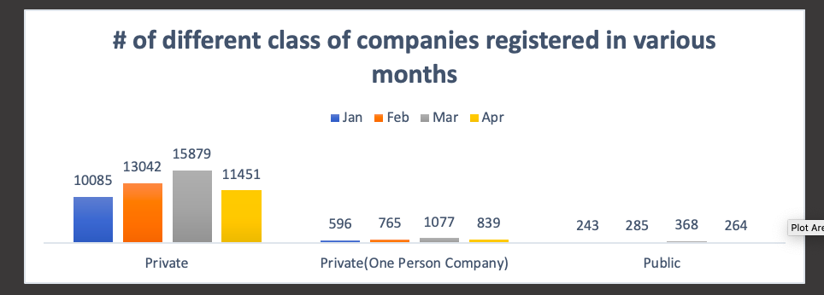
Number of different class of companies registered in various months
It is clearly visible that in march the private companies registered a lot higher than any other month and class.

Slide 16
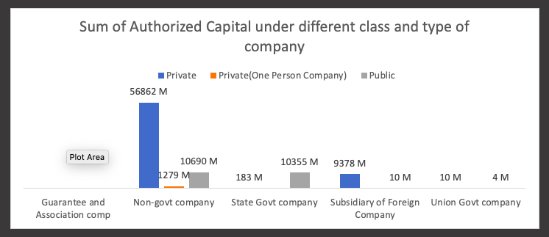
Sum of authorized capital under different class and type of company
The sum of authorized capital of private class non-govt company has the highest value, while public union govt. company has the lowest value.

Slide 17
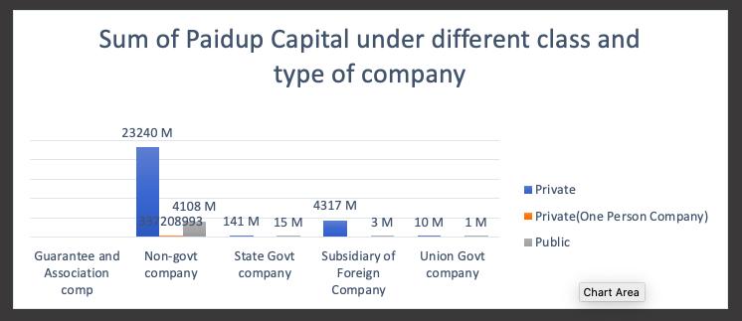
Sum of paid up capital under different class and type of company
The sum of paidup capital of private class non-govt company has the highesDBt value, while public union govt. company has the lowest value.

Slide 18
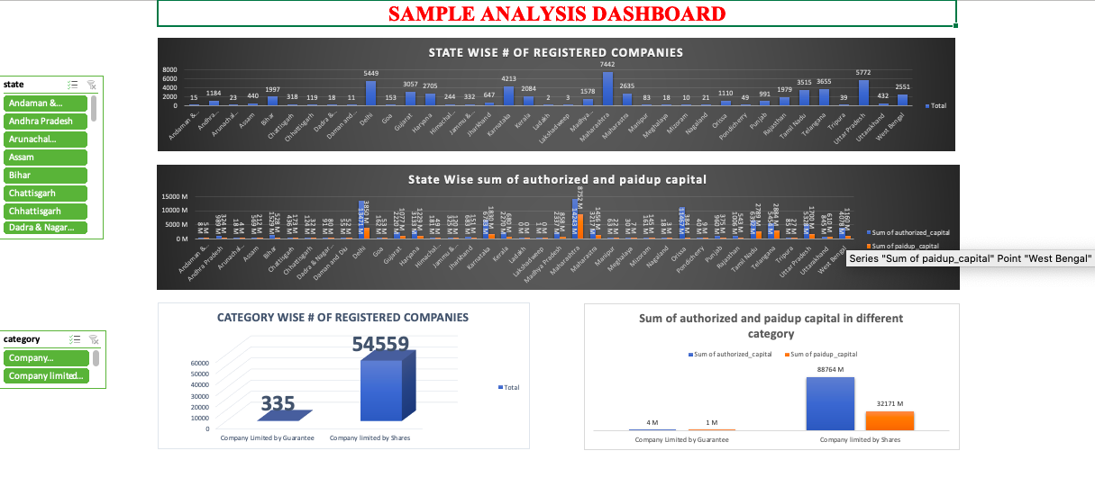
Sum of paid up capital under different class and type of company

Slide 19
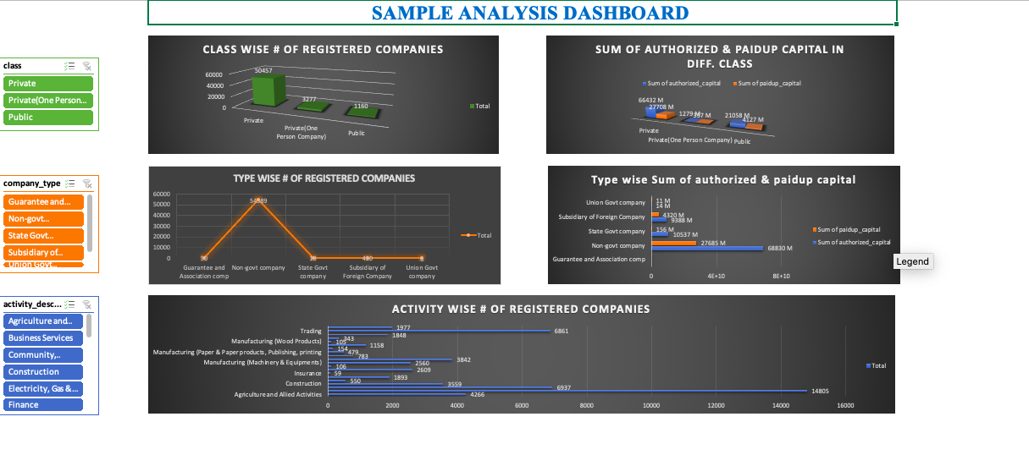
Sum of paid up capital under different class and type of company

Slide 20
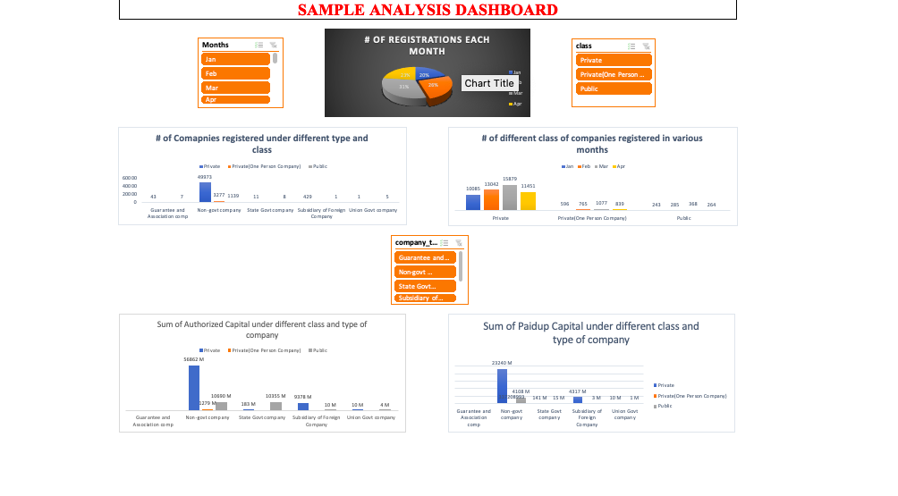
Sum of paid up capital under different class and type of company

Slide 21
CONCLUSION
More numbers of companies can be registered in such a short period of time.
Shall register more number of companies in other class except Private class.
Low registered number of company states needs to be focused.
The higher the authorized capital, higher would be the paid up capital.
More number of company limited by guarantee should be registered.

